Slide 2
Design Principles of AngularJS
Miško Hevery
Father of AngularJS
Brad Green
Manager-guy of AngularJS
Notes:
\

Slide 3
The Principles
Boilerplate
D.R.Y.
Structure
Testability

Slide 4
2009: GetAngular
<angular/>

Slide 5

Project
Results
17,000 LOC
1,500 LOC
Before
with Angular

Slide 6
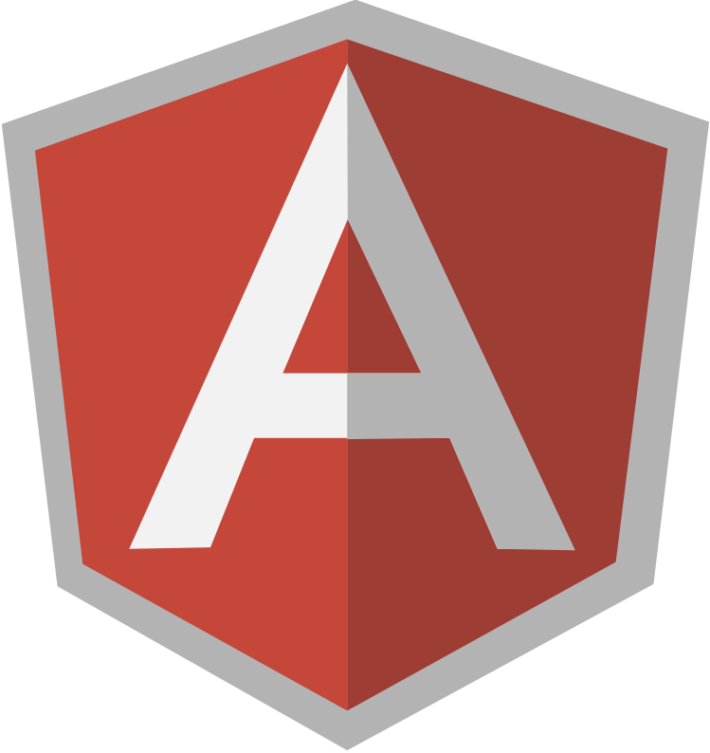
<div>
<span>
<ul>
RAM
Database
<li>
<li>
<li>

Slide 7
Data Binding
Eureka: DOM
<html ng-app>
<body>
<input ng-model='user.name'>
<p ng-show='user.name'>Hi {{user.name}}</p>
<script src='angular.js'></script>
</body>
</html>

Slide 8
{{ databinding }}
<div>
Logic
RAM
<span>
<ul>
<li>
<li>
<li>

Slide 9
MVC
<html ng-app>
<body ng-controller='UserCtrl as uCtrl'>
Hi <input ng-model='uCtrl.user.first'>
<button ng-click='uCtrl.bye()'>bye</button>
<script src='angular.js'></script>
<script src='UserControllers.js'></script>
</body>
</html>
function UserCtrl() {
this.user = {
first:'Larry',
last:'Page'
};
this.bye = function() {
alert('bye:' + this.user.first);
};
}
index.html
UserController.js

Slide 10
Structure
<div>
UI / View
(DOM)
Observes
Data / Model
(JS Objects)
<span>
<ul>
RAM
<li>
Notifies
Manages
Logic / Controller
(JS Classes)
Notes:
Look at the arrows
Logic can be instantiated without view
View is declarative

Slide 11
Dependency Injection
function UserController(voiceSynth) {
this.user = { first:'Larry', last: 'Page' };
this.bye = function() { voiceSynth.say('bye') };
}
function VoiceSynth(webAudio) {
this.say = function(text) {// do Web Audio stuff};
};
var myApp = angular.module('myApp', []);
myApp.controller('UserController', UserController);
myApp.service('voiceSynth', VoiceSynth);
Module: myApp
View (DOM)
UserController
VoiceSynth
WebAudio

Slide 12
Dependency Injection: Mocking
function VoiceSynthMock() {
this.say = function(text) {
this.said.push(text);
};
this.said = [];
};
var myMocks = angular.module('myMocks', ['myApp']);
myApp.service('voiceSynth', VoiceSynthMock);
Module: myMocks -> myApp
View (DOM)
UserController
VoiceSynth
VoiceSynthMock
WebAudio

Slide 13
Imperative
Declarative
{{ databinding }}
ng-hide
ng-controller
ng-model
Eureka!!!
my-tab
my-pane
my-map
Notes:
Imperative for logic
Declarative for templates and configuration

Slide 14
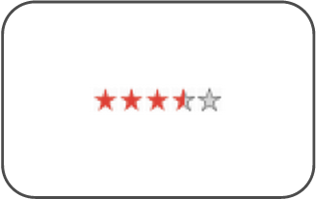
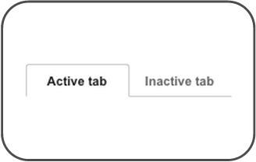
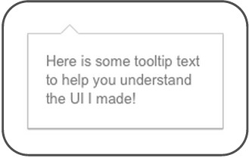
Directives as Components
<rating max="5" model="stars.average">
</rating>
<tabs>
<tab title="Active tab">...</tab>
<tab title="Inactive tab">...</tab>
</tabs>
<span tooltip="{{messages.tip1}}">

Slide 15
Live Coding
Miško types while Brad tap-dances...

Slide 16
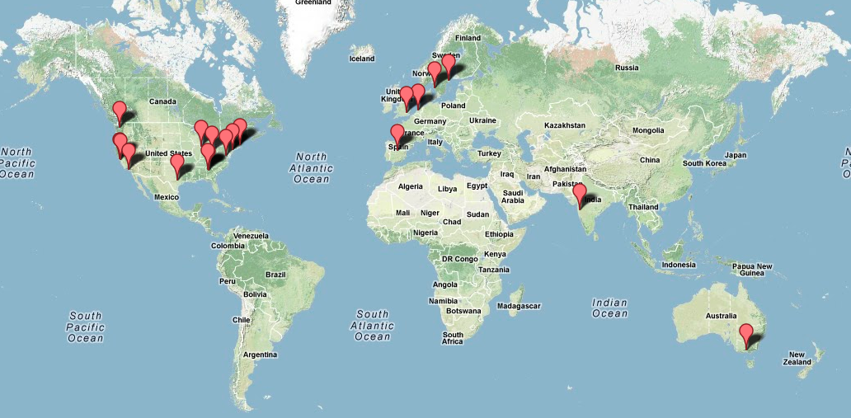
Community

Slide 17



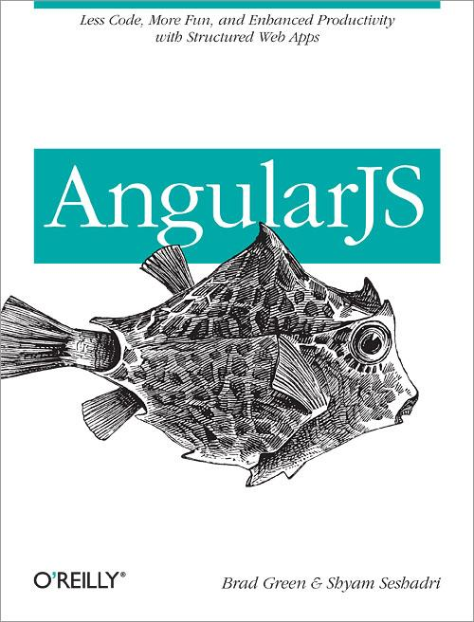
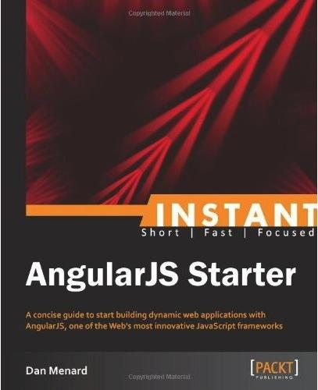




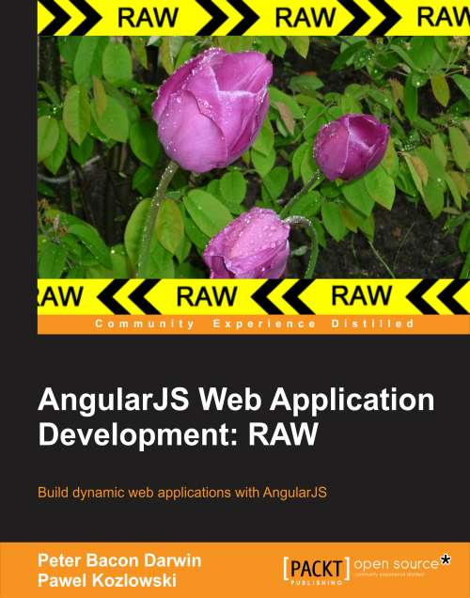
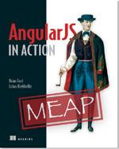



Ecosystem
Tools
UI Components
Libraries
Books
Batarang
AngularUI

Slide 18
Thank You!
angularjs.org
+angularjs
@angularjs
@mhevery
@bradlygreen
Code samples: http://goo.gl/N1sCd
Notes:
https://github.com/mhevery/ng-google-io/commits/master

Slide 20
Notes:
Every web application is a way to get data from the database to the browser and back to the database.
What if one could express the application behavior just by adding markup to the static document.
(we host the DB in the cloud)
Making the marshaling process simple is the basic idea behind Angular and it is our passion.
But now we dropped the DB hosting
B: Misko what was your goal?
M: What do apps do? It is a marshaling problem. USER <-> DB; Could this be done by specifying your intent in HTML rather than in JS. (Center example).
M: This is really my passion. Turning well known problems into do-what-i-mean code

